Slide 1




Full Service Indie Publishing for Open Tools and Content
Dr. Charles Severance
University of Michigan School of Information
www.tsugi.org www.koseu.org
https://www.slideshare.net/csev

Slide 2
TL;DR
Put Indie OER book publishers on an equal footing
Democratize MOOCs
Democratize Learning Object Repositories
Enable the dis-aggregation of LMS systems (a.k.a. NGDLE)
I like building open source software for teachers

Slide 3
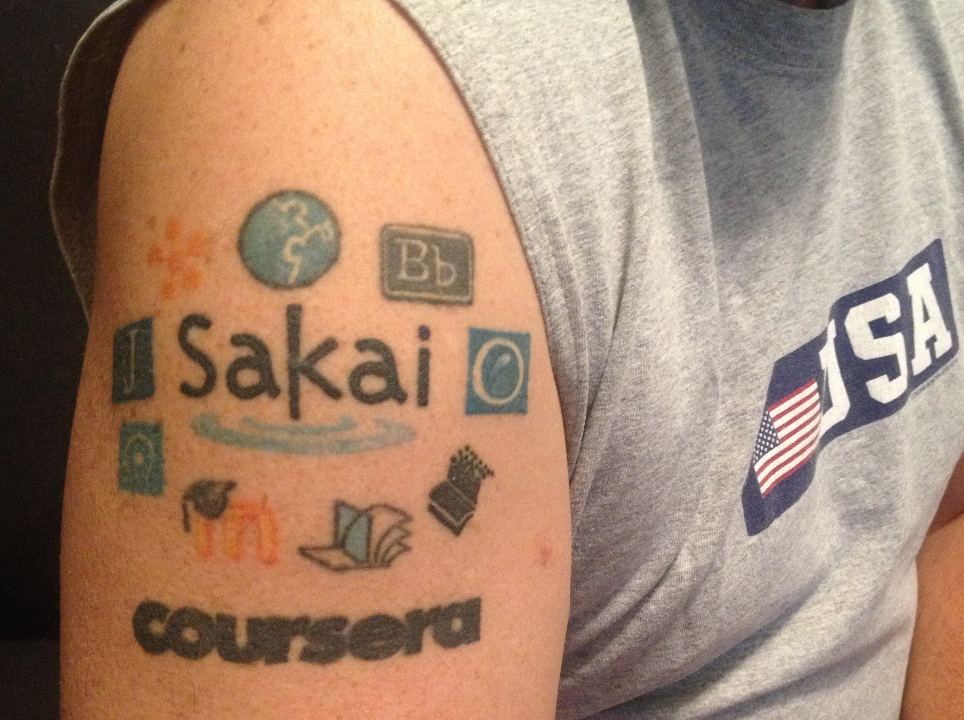
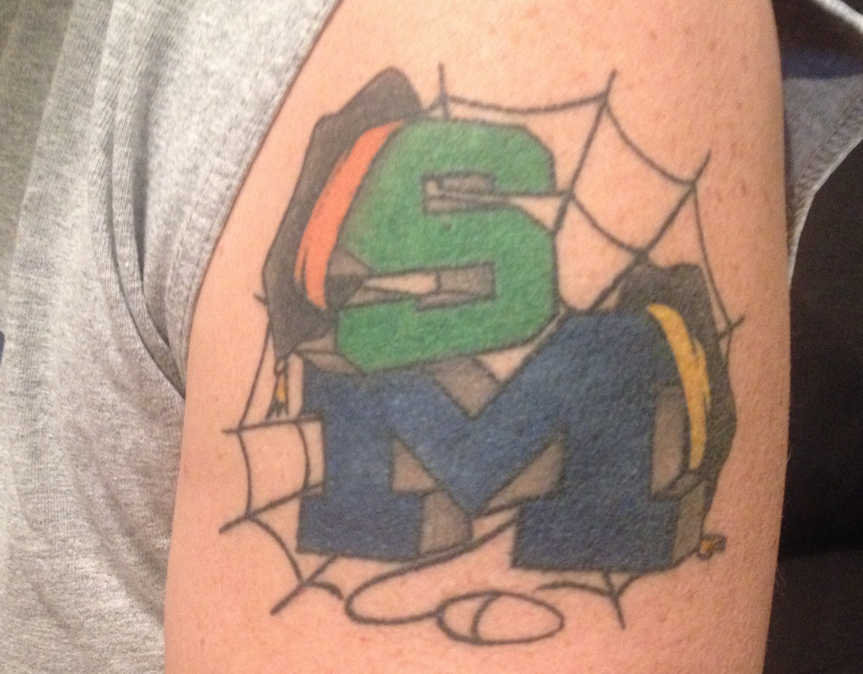
www.masteringphysics.com
www.masteringpython.com

Slide 4

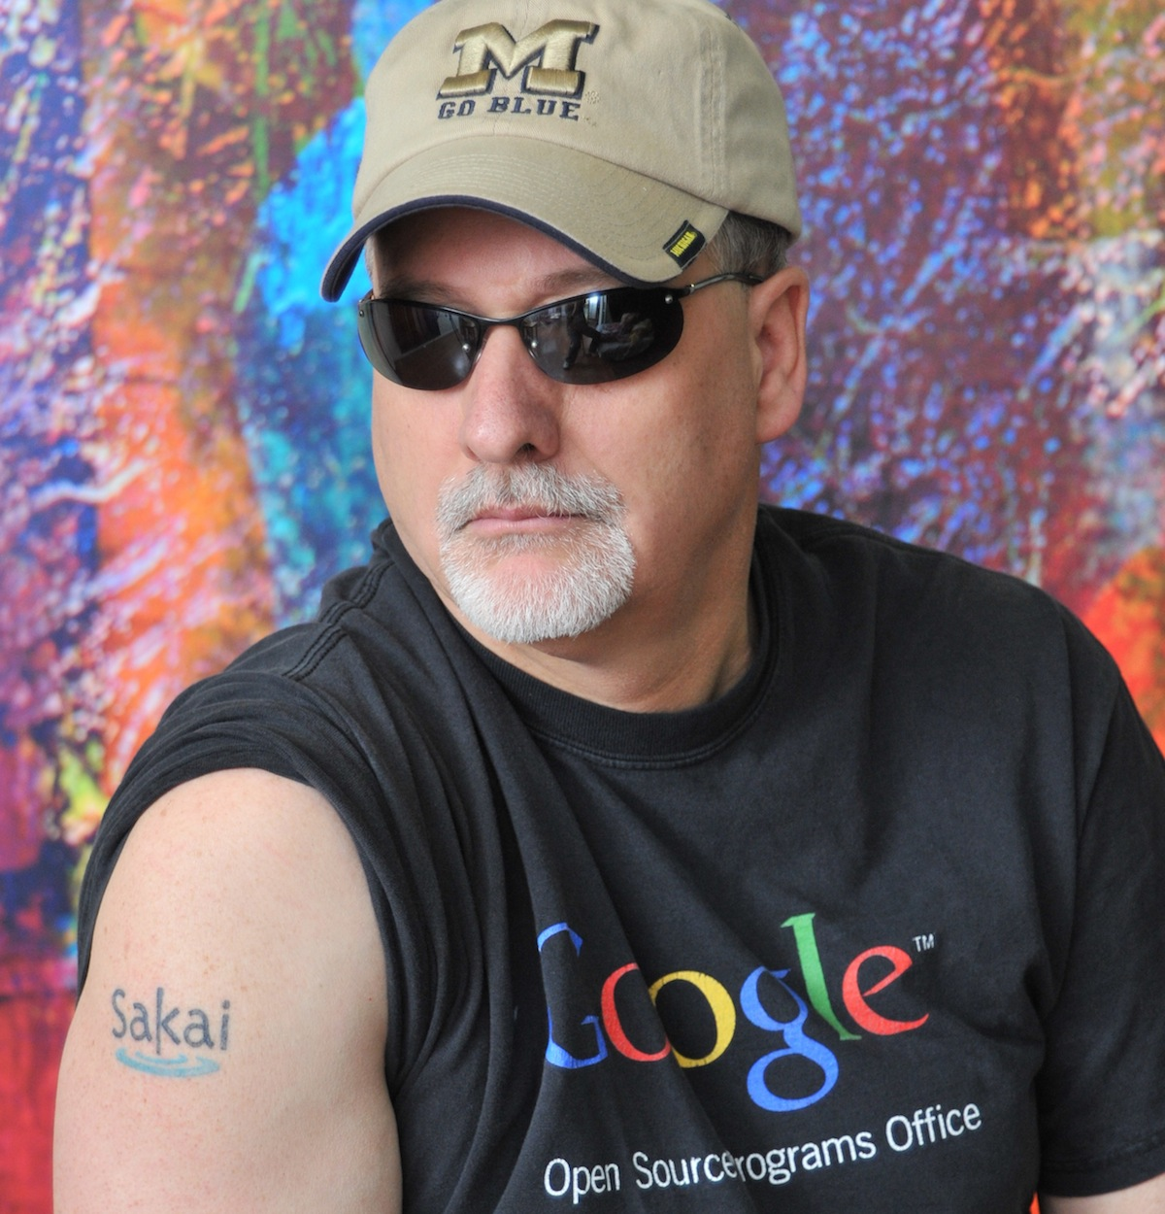
www.masteringphysics.com
www.masteringpython.com

Slide 5
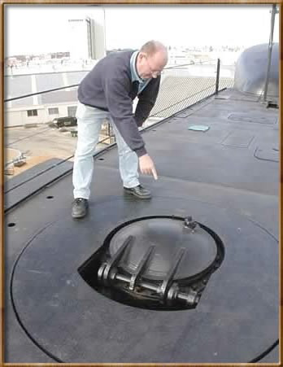

IMS Learning Tools Interoperability

Slide 6
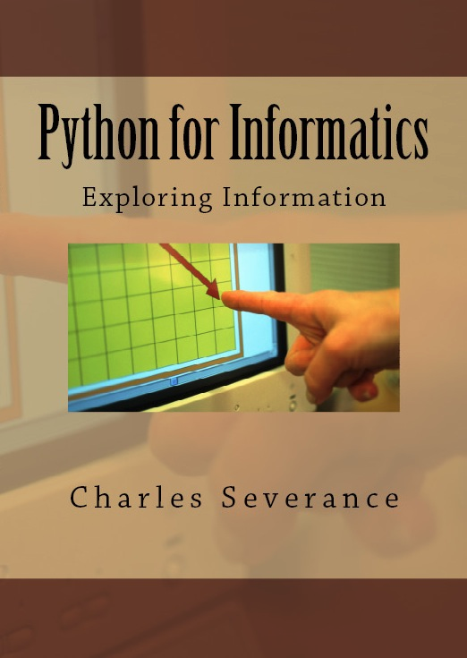
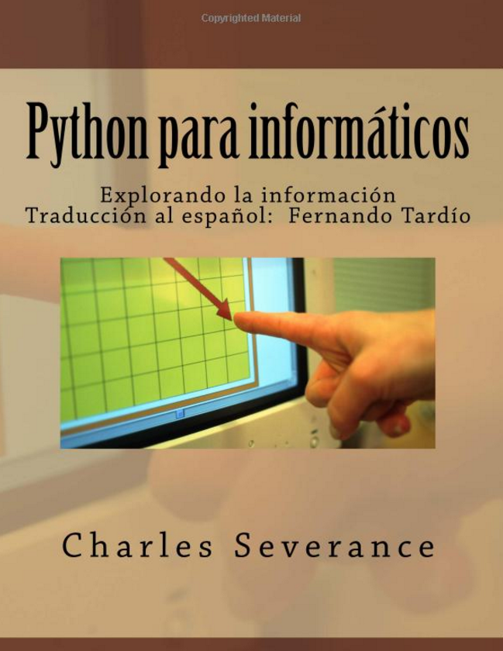
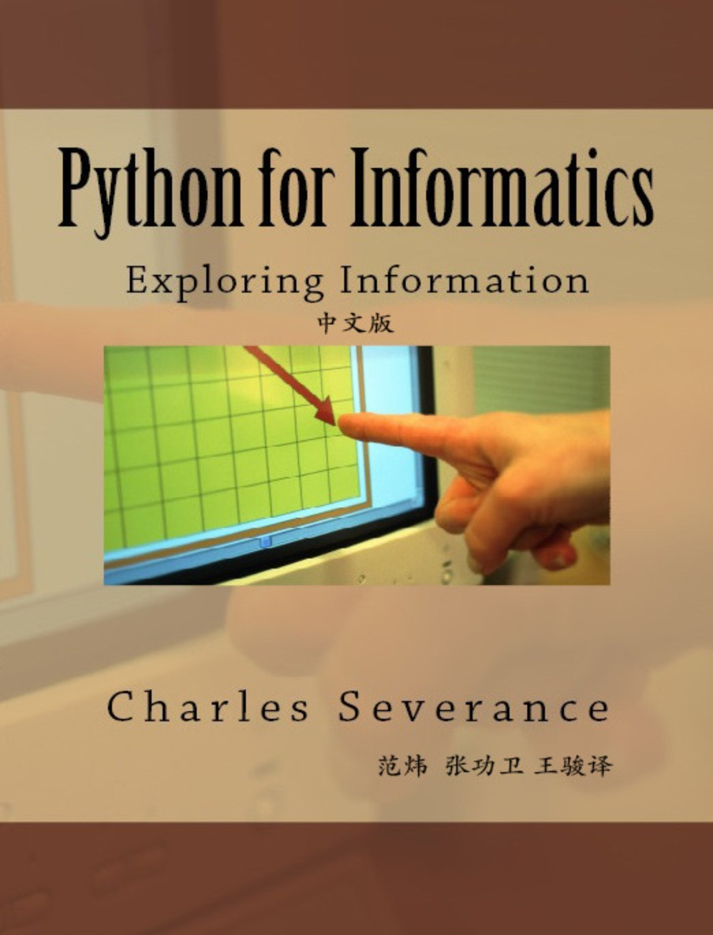
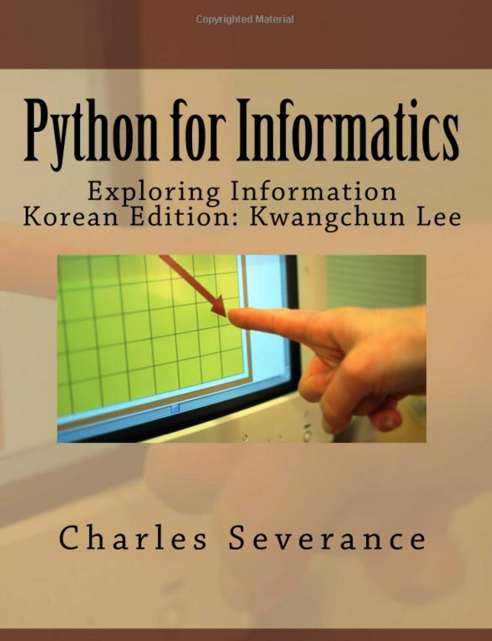


Open Educational Resources

Slide 7
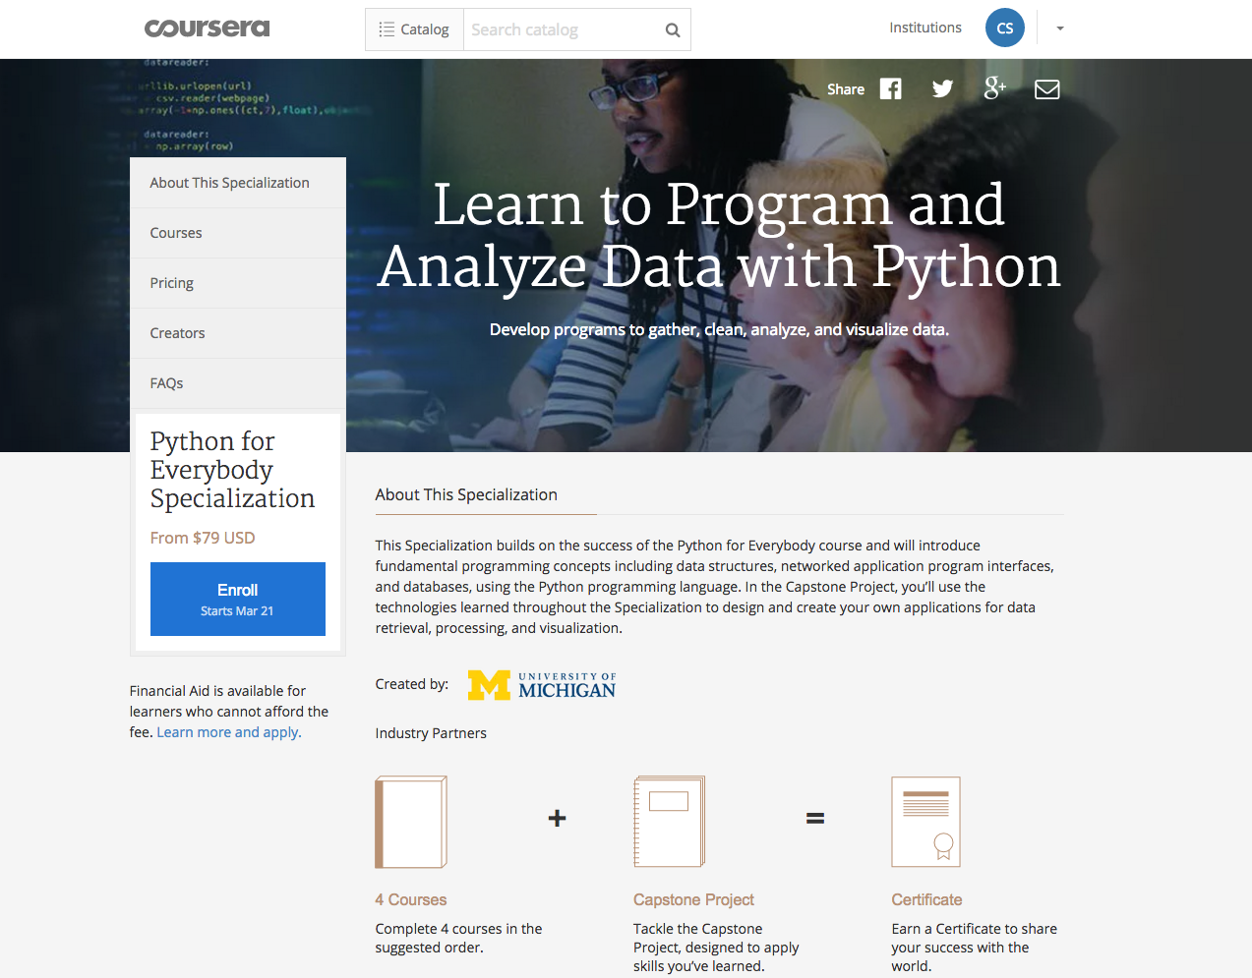

Slide 8

https://commons.wikimedia.org/wiki/File:Michigan_Stadium_Sept_17,2011.jpg

Slide 9
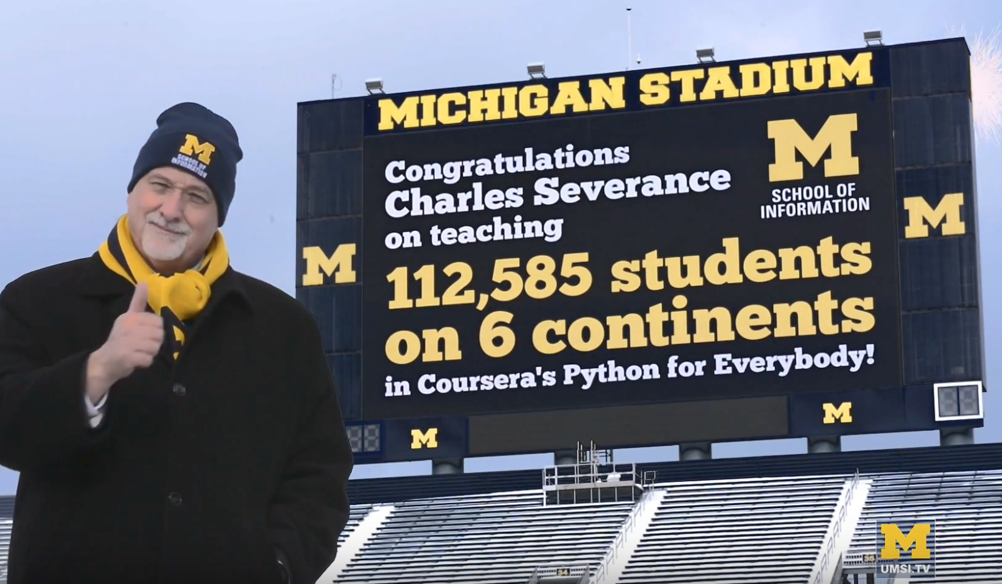
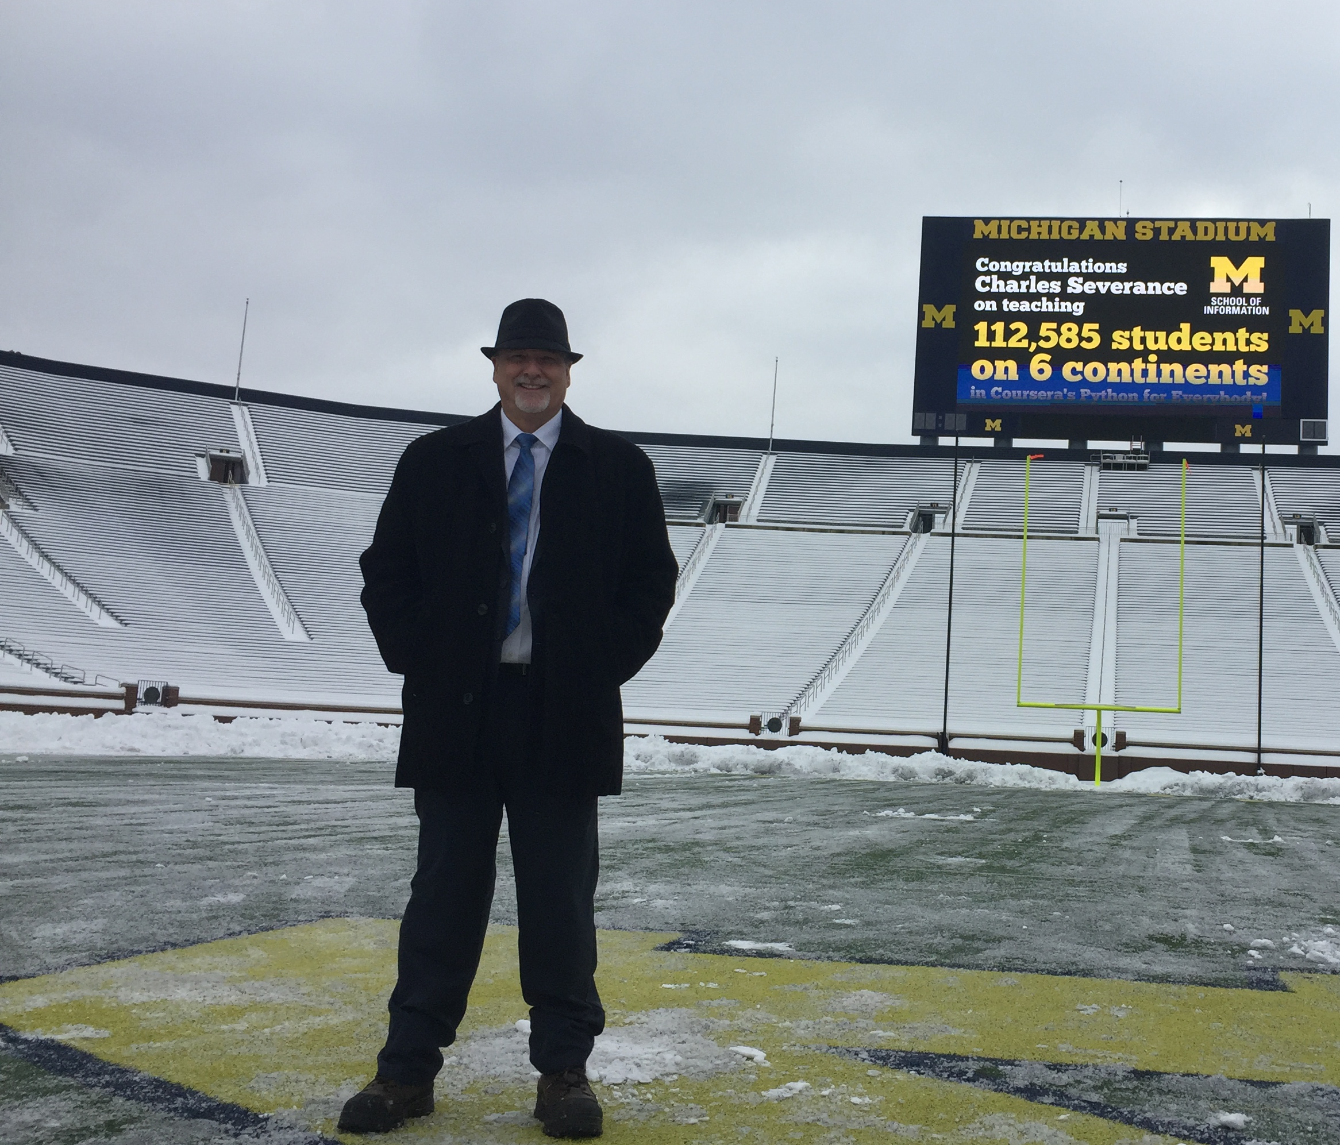
https://www.youtube.com/watch?v=ETGi75aE_OA

Slide 10
TL;DR
Empower Indie publishers
Democratize MOOCs
Democratize LORs
Disaggregate LMS

Slide 11
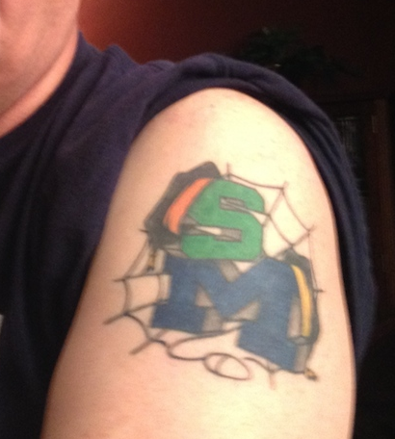
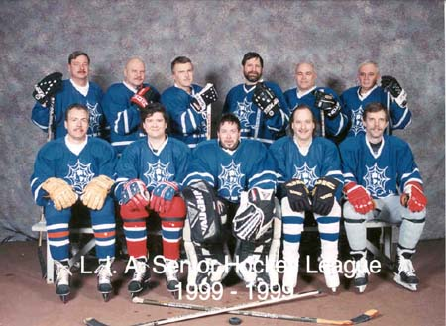

Slide 12
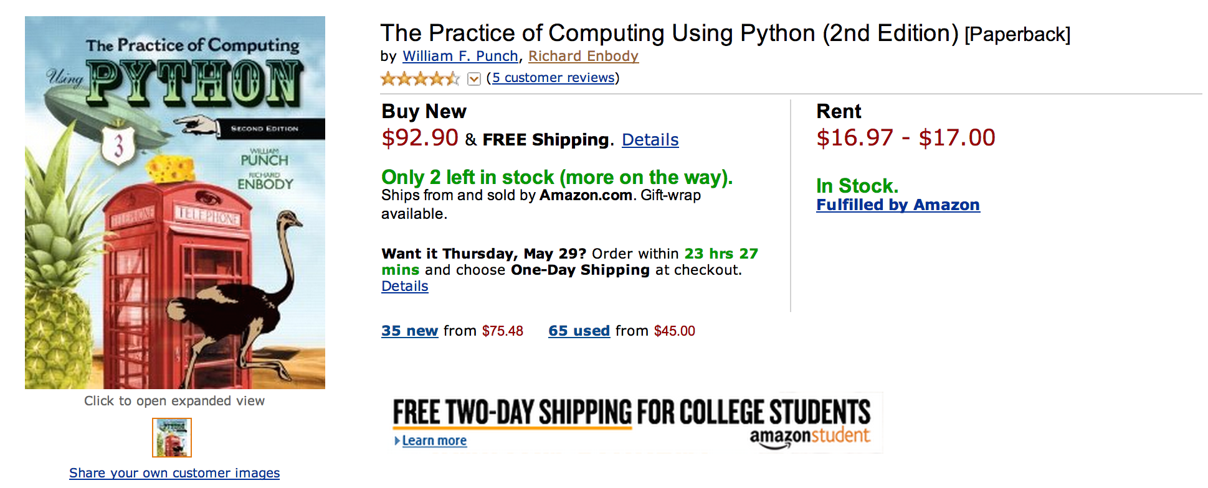
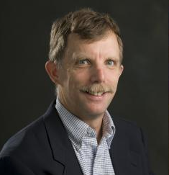
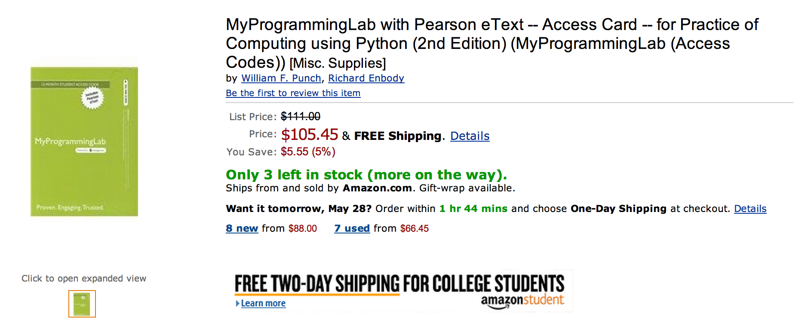

Slide 13
What does $198.35 get you?
Book
Automatic Homework Grading Software
Learning Management System Integration
Instructor Materials
Slides / Solutions Manual / Exams / Course Copy
Instructor Training
Notes:
$65 from Pearson $130 Form bookstore

Slide 14

Teacher Prep
Book
Pearson Value
Proposition
$200
Marketing
Software

Slide 15
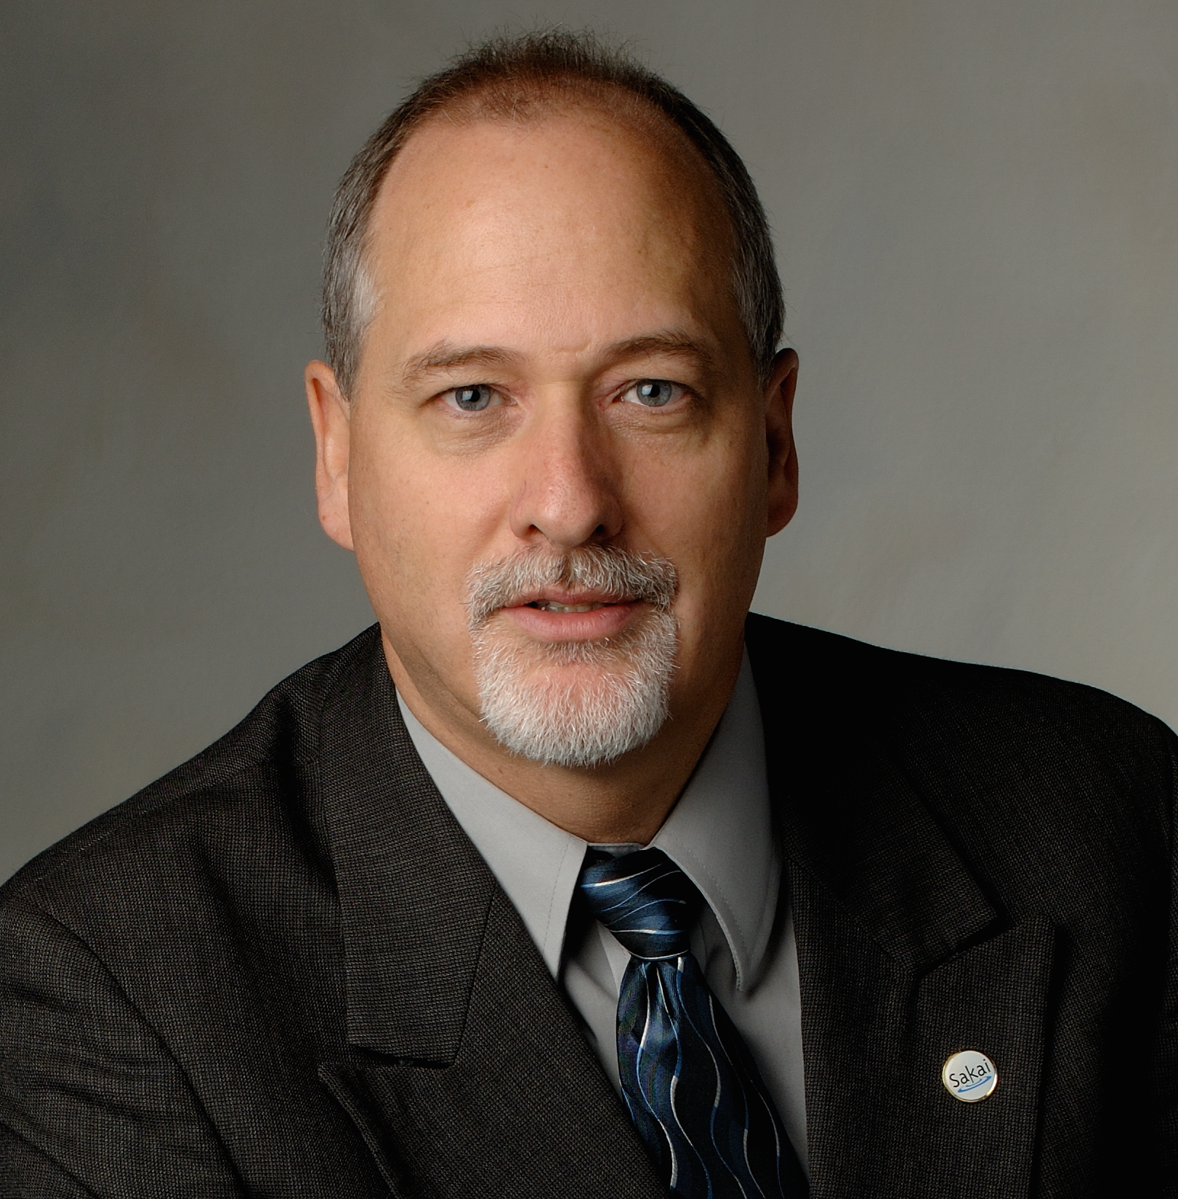



Slide 16
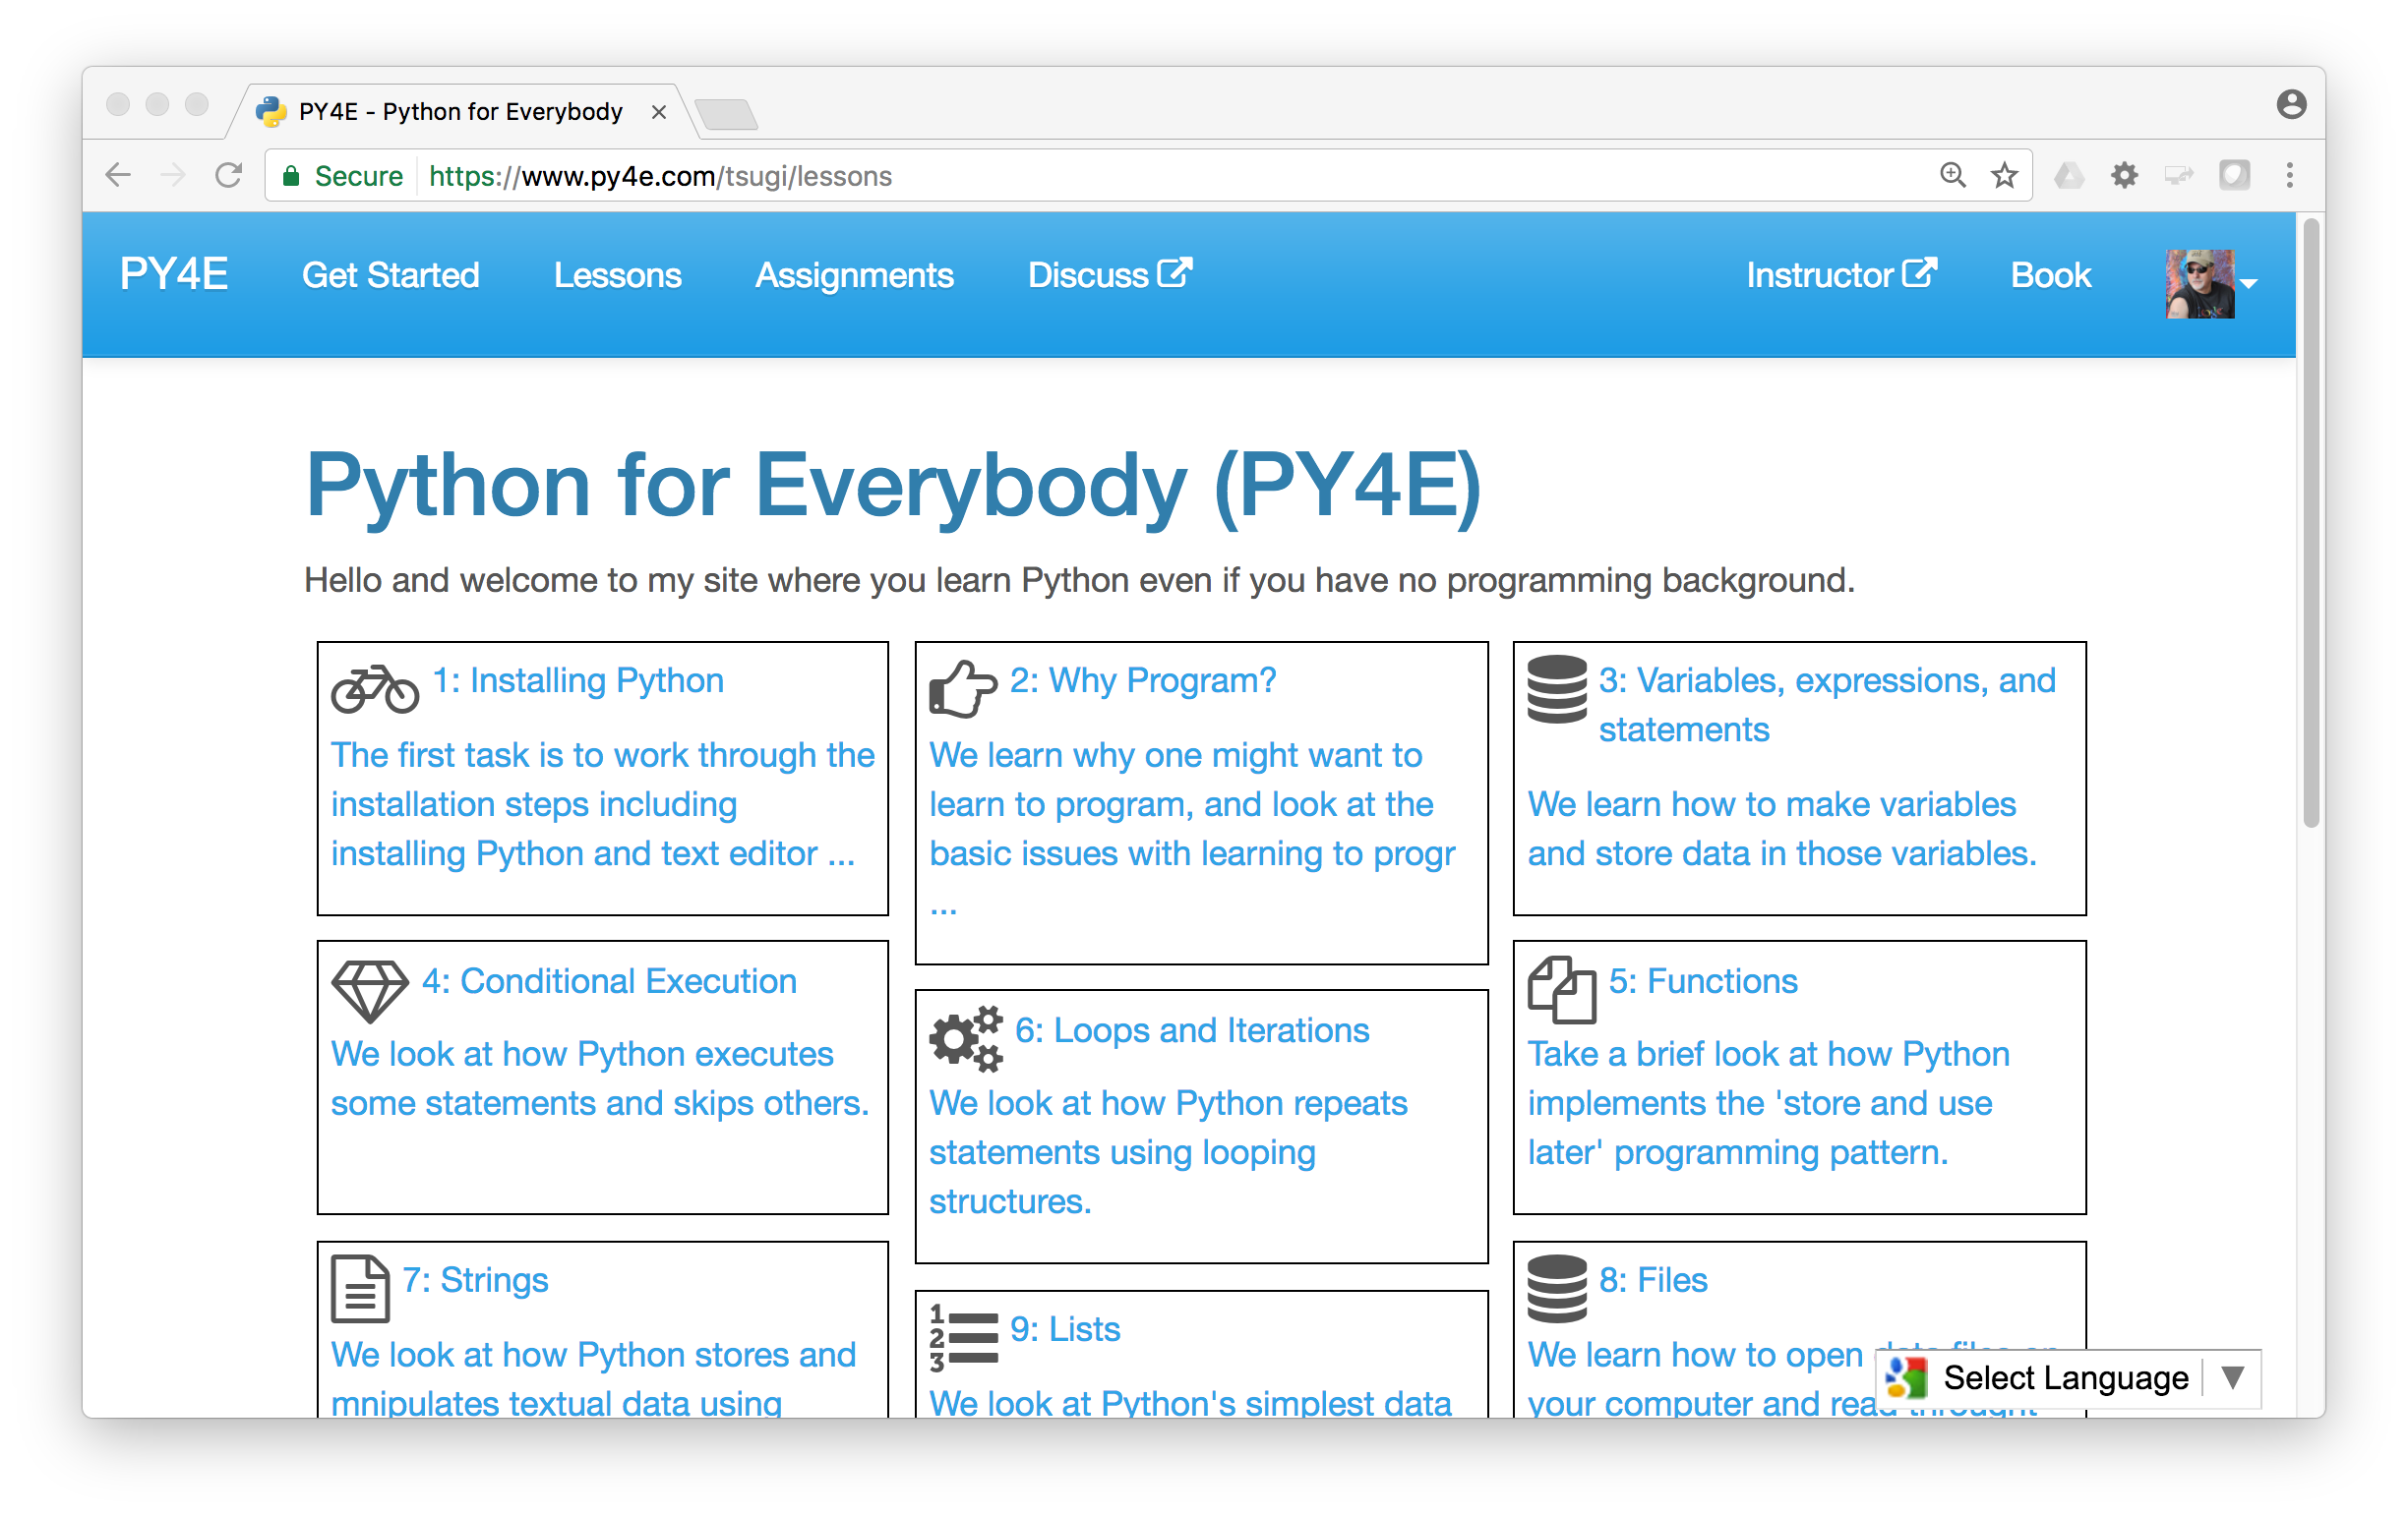
www.py4e.com (a.k.a. www.masteringpython.com)

Slide 17
The World's Simplest LMS/LOR/MOOC
$ composer require --dev koseu/lib
koseu.php:
<?php
define('COOKIE_SESSION', true);
require_once "tsugi/config.php";
// Pull in the Koseu LMS (/lessons, /map, /badges ...)
$launch = \Tsugi\Core\LTIX::session_start();
$app = new \Koseu\Core\Application($launch);
$app->run();
https://github.com/tsugiproject/koseu-php

Slide 18
CONTENT ITEM®
CC®
LTI®
IMS CONTENT ITEM® FILLS THE GAPS AND MAKES CONNECTIONS BETWEEN IMS LEARNING TOOLS INTEROPERABILITY® AND IMS COMMON CARTRIDGE®.
LTI®, CC®, and Content Item® are trademarks of IMS Global Learning Consortium, Inc. (www.imsglobal.org)

Slide 19
CONTENT ITEM®
CC®
LTI®
FOR THE FIRST TIME IN THE HISTORY OF EDUCATIONAL TECHNOLOGY, YOU CAN MAKE AN APP STORE AND LEARNING OBJECT REPOSITORY WITHOUT PROPRIETATY EXTENSIONS.
LTI®, CC®, and Content Item® are trademarks of IMS Global Learning Consortium, Inc. (www.imsglobal.org)

Slide 20

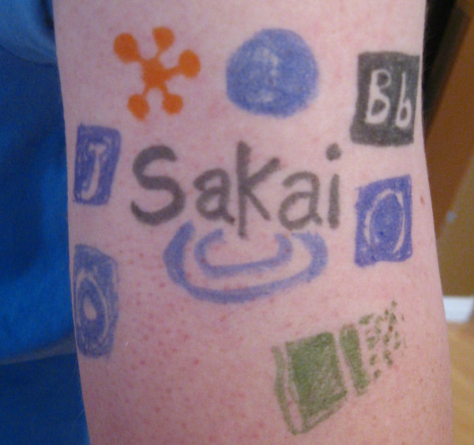
@drchuck
@whitmer
@brackenm

Slide 21
Topics
Educational App Store
API Libraries
"Lego Blocks"
Interoperability
New tools that *teach*
EdTech startups made easy
Training / Documentation
Enrich Open Educational Content
Seamless Content Integration and Reuse (LOR)
Stand-Alone MOOC platform
LMS based on Tsugi technology
koseu.org (코스)

Slide 22

CreateSpace
10
Pandoc
py4e.com
App Store (次)
OER Content (코스)
3K
github
1.2M
Coursera
Media
UM/Canvas
300
archive.org
Amazon
YouTube
ITunes
GooglePlay

Slide 23
Demo (time permitting)

Slide 24
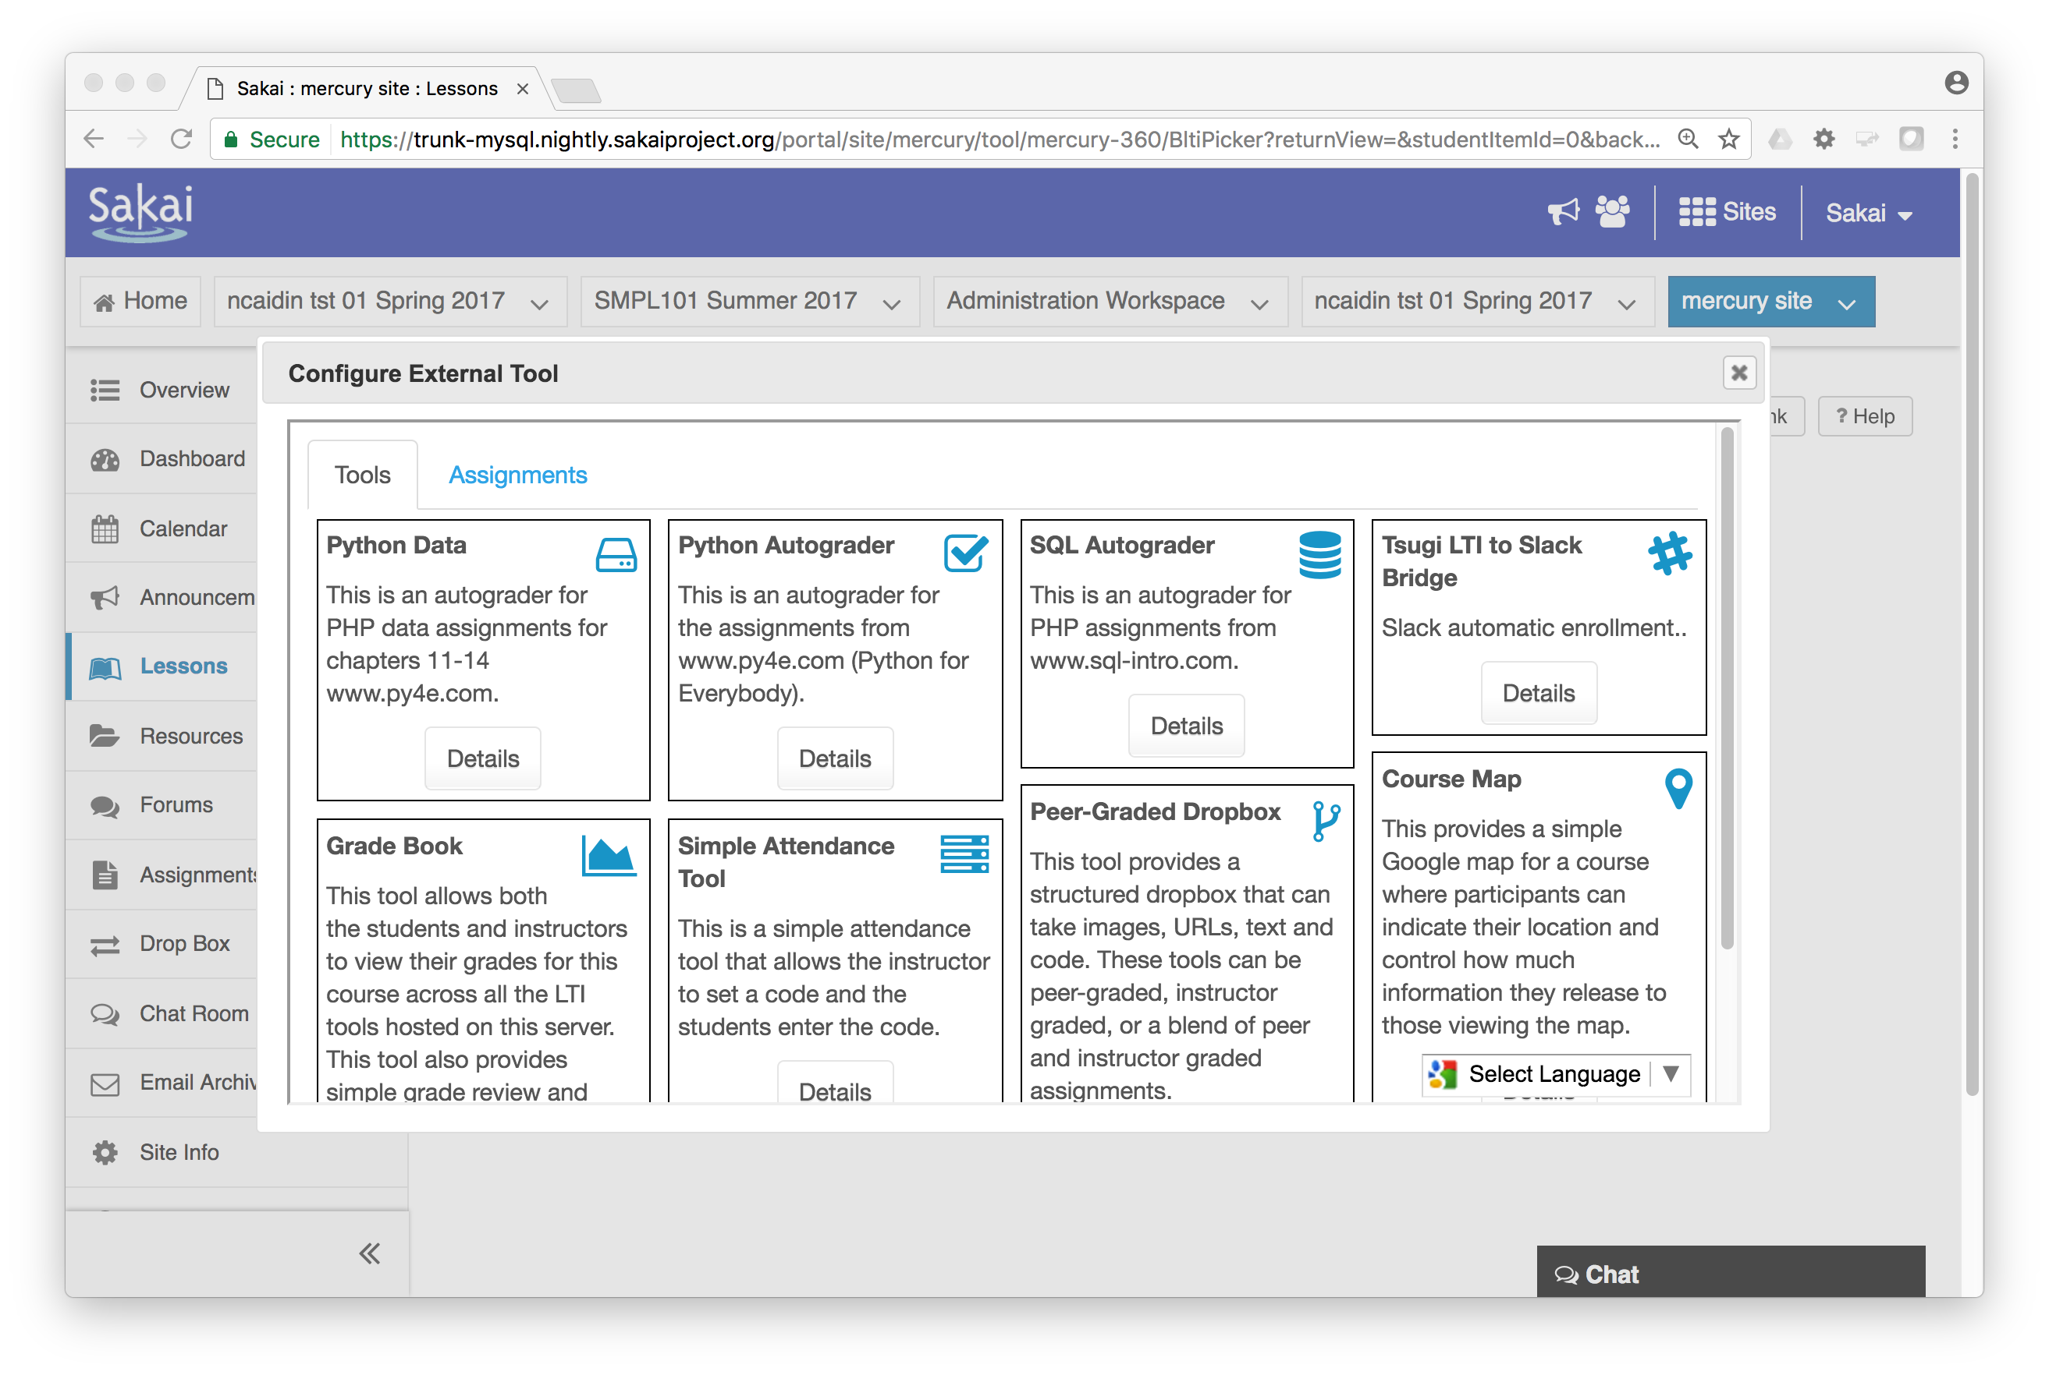

Slide 25
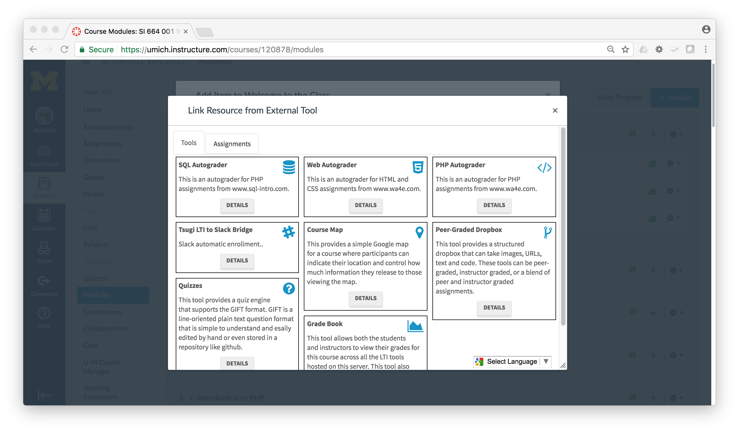

Slide 26
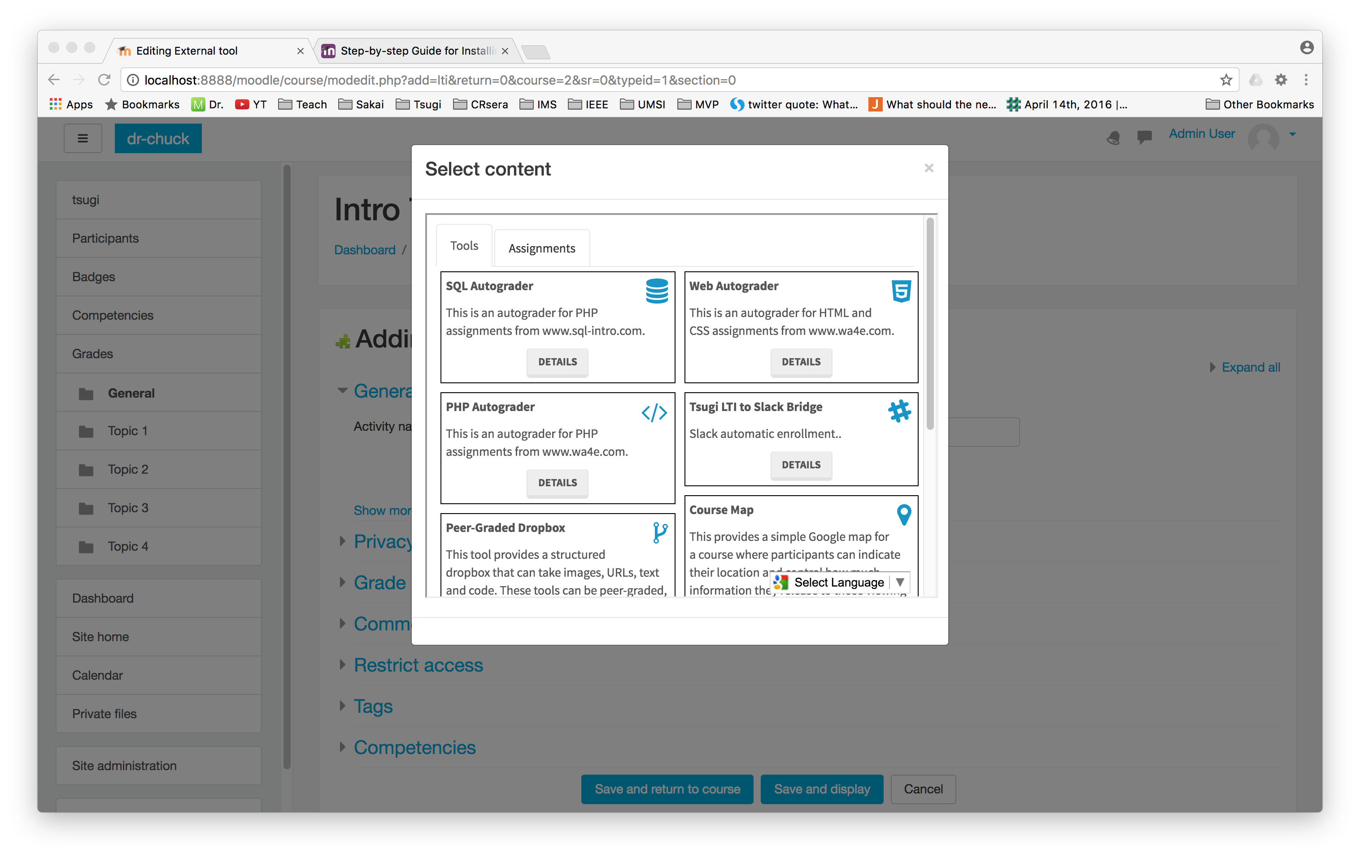

Slide 27
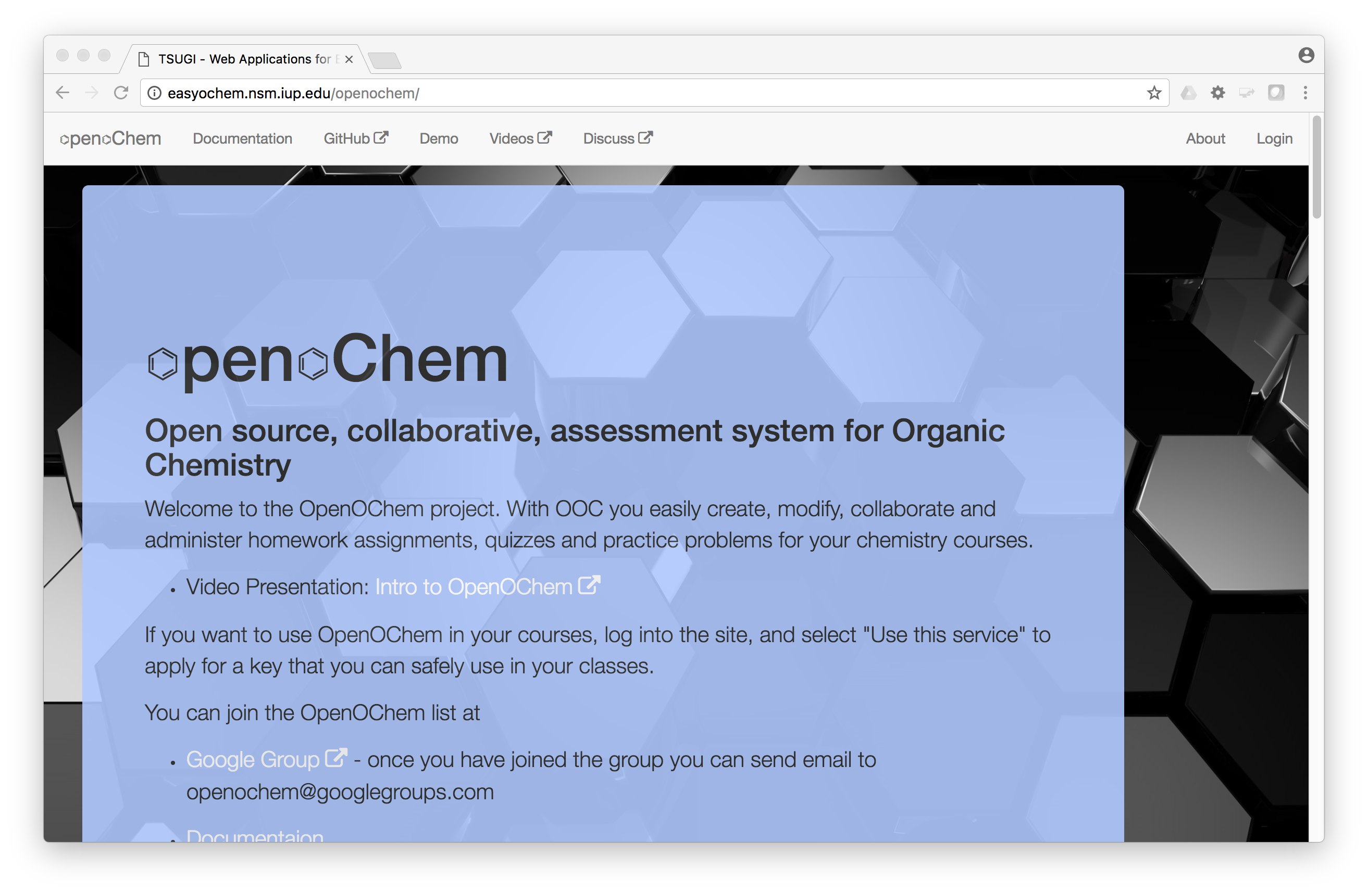
Carl LeBlond, Indiana University of Pennsylvania

Slide 28
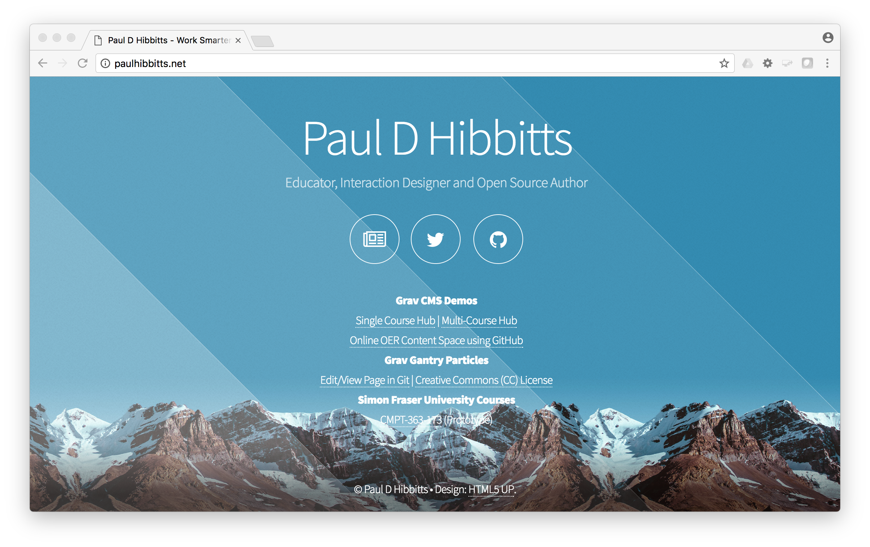

Slide 29

Any Questions? www.tsugi.org www.py4e.com www.wa4e.com

